Slide 1
STRUCTURAL TESTING
DATA FLOW TESTING

Slide 2
Data Flow Testing
Data flow testing is another form of structural testing.
Statements where variables receive values.
Statements where these values are used or referenced.

Slide 3
Data Flow Testing
As we know, variables are defined and referenced throughout the program. We may have few define/ reference anomalies:
  A variable is defined but not used/referenced
  A variable is used but never defined.
  A variable is defined twice before it is used.

Slide 4
Data Flow Testing
Definitions
  Defining node
  A node of a flow graph is a defining node for a variable v, if and only if, the value of the variable v is defined in the statement corresponding to that node.
  It is represented as DEF(v,n) where v is the variable and n is the node corresponding to statement in which v is defined.
  Usage node
  A node of a flow graph is a usage node for a variable v, if and only if, the value of the variable v is used in the statement corresponding to that node.
  It is represented as USE(v,n) where v is the variable and n is the node corresponding to statement in which v is used.

Slide 5
Data Flow Testing
Definitions
  Definition use path
  A definition use path (du-path) for a variable v is a path between two nodes m and n where m is the initial but defining node for variable v and n is the final but usage node for variable v.
  Definition clear path
  A definition clear path for a variable v is a definition use path with initial and final nodes DEF(v,m) and USE(v,n), such that no other node in the path is a defining node of variable v.

Slide 6
Data Flow Testing
Identification of du and dc paths
  Draw the flow graph of the program.
  Convert flow graph into DD path graph.
  Find all variables of the program and prepare a table for define/use status of all variables using the following format
S. No | Variable(s) | Defined at node | Used at node

Slide 7
Data Flow Testing
Identification of du and dc paths
  Generate all du-paths from define/use variable table of step (iii).
  Identify those du-paths which are not definition clear (dc-paths) paths.
Testing strategies using du-paths
  Test all du-paths
  All du-paths generated for all variables are tested. This is the strongest data flow testing strategy covering all possible du-paths.
  Test all uses
  Find at least one path from every definition of every variable to every use of that variable which can be reached by that definition.

Slide 8
Data Flow Testing
Testing strategies using du-paths
  Test all definitions
  Find paths from every definition of every variable to at least one use of that variable.
Generation of test cases
  After finding paths, test cases are generated by giving values to the input parameter. We get different test suite for each variable.

Slide 9
Data Flow Testing
Consider the program to find the largest amongst three numbers. Find all du paths and identify those du-paths that are definition clear. Also find all du-paths, all uses and all-definitions and generate test cases

Slide 10
1 | void main()
2 | {
3 | float A,B,C;
4 | clrscr();
5 | printf("Enter number 1:\n");
6 | scanf("%f", &A);
7 | printf("Enter number 2:\n");
8 | scanf("%f", &B);
9 | printf("Enter number 3:\n");
10 | scanf("%f", &C);
11 | if(A>B) {
12 | if(A>C) {
13 | printf("The largest number is: %f\n",A);
14 | }
15 | else {
16 | printf("The largest number is: %f\n",C);
17 | }
18 | }
19 | else {
20 | if(C>B) {
21 | printf("The largest number is: %f\n",C);
22 | }
23 | else {
24 | printf("The largest number is: %f\n",B);
25 | }
26 | }
27 | getch();
28 | }

Slide 11
Data Flow Testing
1
2
3
4
5
6
7
8
9
10
11
12
19
13
15
20
14
16
21
23
17
22
24
18
25
27
26
Control Flow Graph
28

Slide 12
Data Flow Testing
Flow graph nodes | DD path graph corresponding node | Remarks
1 to 10 | N1 | There is a sequential flow from node 1 to 10
11 | N2 | Decision node, if true goto 12, else goto 19
12 | N3 | Decision node, if true goto 13 else goto 15
13, 14 | N4 | Sequential nodes
15, 16, 17 | N5 | Sequential nodes
18 | N6 | Two edges 14 and 17 are terminated here
19 | N7 | Intermediate node terminated at node 20
20 | N8 | Decision node, if true goto 21 else goto 23
21, 22 | N9 | Sequential nodes
23, 24, 25 | N10 | Sequential nodes
26 | N11 | Two edges 22 and 25 are terminated here
27 | N12 | Two edges 18 and 26 are terminated here
28 | N13 | Exit node

Slide 13
Data Flow Testing
N1
N2
N3
N7
N4
N5
N8
N6
N9
N10
N11
N12
N13
DD Path Graph

Slide 14
Data Flow Testing
S. No | Variable(s) | Defined at node | Used at node
1 | A | 6 | 11,12,13
2 | B | 8 | 11,20,24
3 | C | 10 | 12,16,20,21

Slide 15
Data Flow Testing
S. No | Variable(s) | Du-path
1 | A | 6,11 6,12 6,13
2 | B | 8,11 8,20 8,24
3 | C | 10,12 10,16 10,20 10,21

Slide 16
Data Flow Testing
S. No | Path | Definition clear?
All du-paths and all uses | 6,7,8,9,10,11 6,7,8,9,10,11,12 6,7,8,9,10,11,12,13 8,9,10,11 8,9,10,11,19,20 8,9,10,11,19,20,23,24 10,11,12 10, 11,12,15,16 10,11,19,20 10,11,19,20,21 | Yes Yes Yes Yes Yes Yes Yes Yes Yes Yes
All definitions | 6,7,8,9,10,11 8,9,10,11 10,11,12 | Yes Yes Yes

Slide 17
Data Flow Testing
S. No | A | B | C | Expected output | Path
1 2 3 4 5 6 7 8 9 10 | 9 9 9 7 7 7 8 8 7 7 | 8 8 8 9 9 9 7 7 8 8 | 7 7 7 8 8 8 9 9 9 9 | 9 9 9 9 9 9 9 9 9 9 | 6,7,8,9,10,11 6,7,8,9,10,11,12 6,7,8,9,10,11,12,13 8,9,10,11 8,9,10,11,19,20 8,9,10,11,19,20,23,24 10,11,12 10, 11,12,15,16 10,11,19,20 10,11,19,20,21
Test All du-paths and uses

Slide 18
Data Flow Testing
S. No | A | B | C | Expected output | Path
1 2 3 | 9 7 8 | 8 9 7 | 7 8 9 | 9 9 9 | 6,7,8,9,10,11 8,9,10,11 10,11,12
Test All Definitions

Slide 19
Data Flow Testing
1
Def(a,1) , Def(b,1)
2
3
5
4
6
Use(a,7)
7
9
Use(b,9)
Use(b,8)
8
10
Use(a,10)
11

Slide 20
Data Flow Testing
Variables | Defined at node | Used at Node
a | 1 | 7,10
b | 1 | 8,9
Def/use nodes table
Variables | Du path(begin, end) | Definition clear
a | 1,7 1,10 | Yes
b | 1,8 1,9 | Yes
Du paths

Slide 21
Data Flow Testing
All du paths (8 paths)
1,2,3,4,6,7
1,2,5,6,7
1,2,3,4,6,9,10
1,2,5,6,9,10
1,2,3,4,6,7,8
1,2,5,6,7,8
1,2,3,4,6,9
1,2,5,6,9
All uses
(4 paths)
1,2,3,4,6,7
1,2,3,4,6,9,10
1,2,3,4,6,7,8
1,2,3,4,6,9
All definitions
(2 paths)
1,2,3,4,6,7
1,2,3,4,6,7,8
When we identify du paths there may be some impossible paths

Slide 22
Exercise
Consider the program of classification of triangle. Its input is a triple of positive integers (a, b, c) and values for each of these may be from interval [0, 100]. The output may have one of the options given below:
Obtuse angled triangle
Acute angled triangle
Right angled triangle
Invalid triangle
Input values out of range
Find all du-paths and identify those du-paths that are definition clear. Also find all du-paths, all-uses and all-definitions and generate test cases from them.

Slide 23
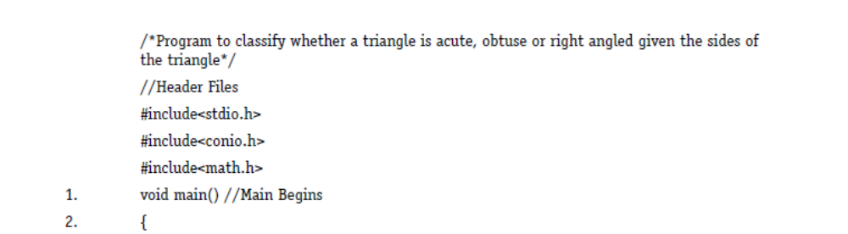
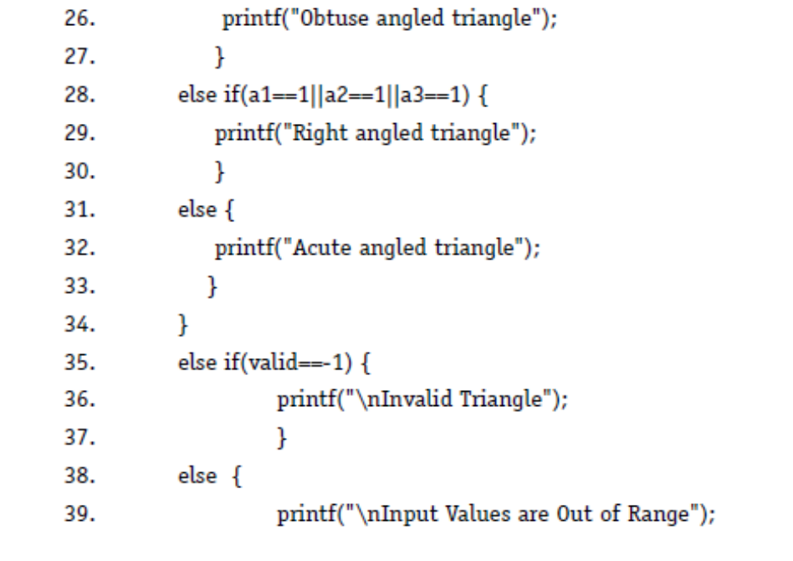
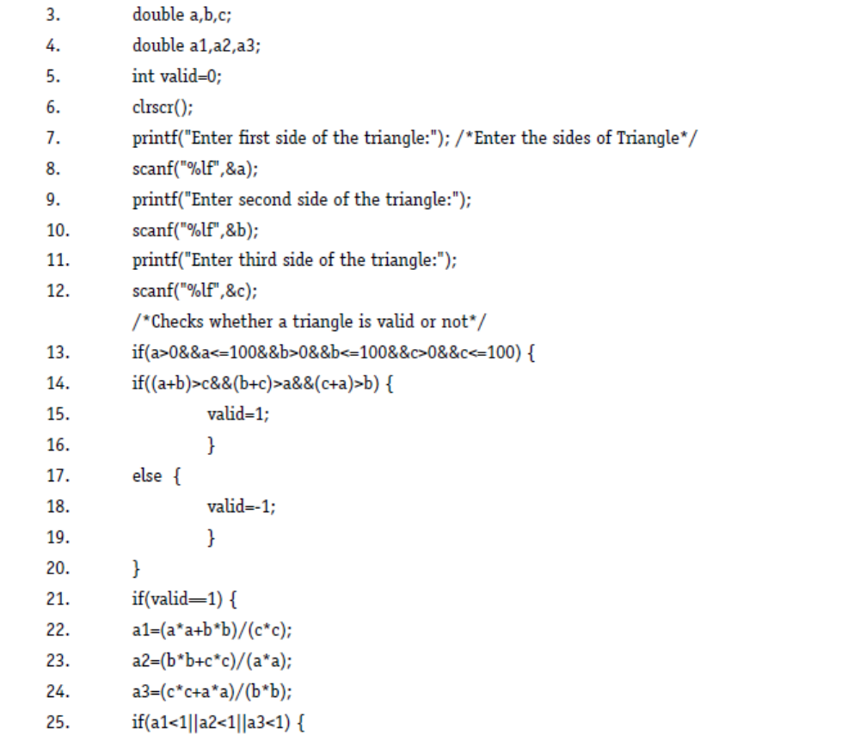
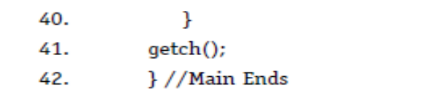

Slide 24
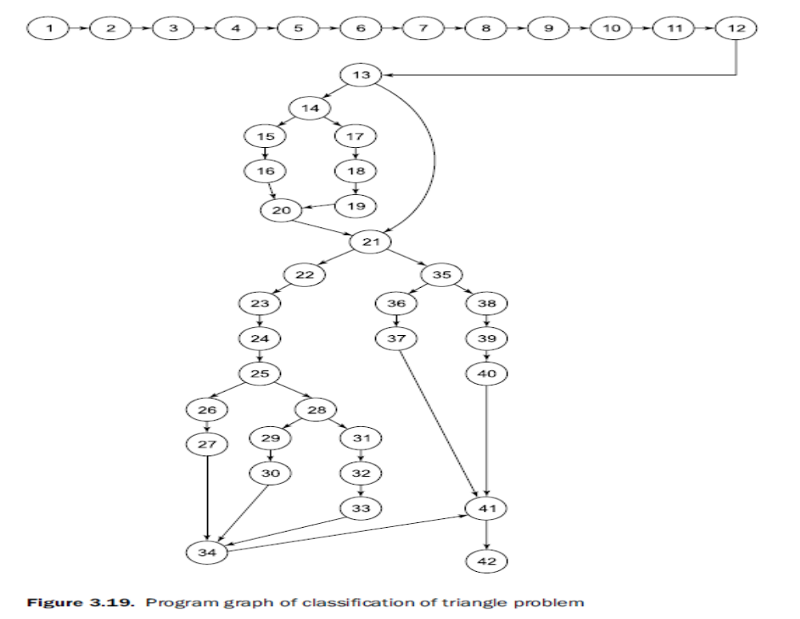

Slide 25
Solution
S.No. | Variable | Defined at node | Used at node
1 | a | 8 | 13, 14, 22, 23, 24
2 | b | 10 | 13, 14, 22, 23, 24
3 | c | 12 | 13, 14, 22-24
4 | a1 | 22 | 25. 28
5 | a2 | 23 | 25, 28
6 | a3 | 24 | 25, 28
7 | valid | 5, 15, 18 | 21, 35

Slide 26
Solution
S.No. | Variable | du-path (Begin, end)
1 | a | 8, 13 8, 14 8, 22 8, 23 8, 24
2 | b | 10, 13 10, 14 10, 22 10, 23 10, 24
3 | c | 12, 13 12, 14 12, 22 12, 23 12, 24
4 | a1 | 22. 25 22, 28

Slide 27
Solution
S.No. | Variable | du-path (Begin, end)
5 | a2 | 23, 25 23, 28
6 | a3 | 24, 25 24, 28
7 | Valid | 5, 21 5, 35 15, 21 15, 35 18, 21 18, 35

Slide 28
All du paths
All du paths | Definition clear? | All du paths | Definition clear?
8-13 | Yes | 12-14, 17-22 | Yes
8-14 | Yes | 12, 13, 21, 22 | Yes
8-16, 20-22 | Yes | 12-16, 20-23 | Yes
8-14, 17-22 | Yes | 12-14, 17-23 | Yes
8-13, 21,22 | Yes | 12, 13, 21-23 | Yes
8-16, 20-23 | Yes | 12-16, 20-24 | Yes
8-14, 17-23 | Yes | 12-14, 17-24 | Yes
8-13, 21-23 | Yes | 12, 13, 21-24 | Yes
8-16, 20-24 | Yes | 22-25 | Yes
8-14, 17-24 | Yes | 22-25, 28 | Yes
8-13, 21-24 | Yes | 23-25 | Yes

Slide 29
All du paths
10-13 | Yes | 23-25, 28 | Yes
10-14 | Yes | 24, 25 | Yes
10-16, 20-22 | Yes | 24, 25, 28 | Yes
10-14, 17-22 | Yes | 5-16, 20, 21 | No
10-13, 21,22 | Yes | 5-14, 17-21 | No
10-16, 20-23 | Yes | 5-13, 21 | Yes
10-14, 17-23 | Yes | 5-16, 20, 21, 35 | No
10-13, 21-23 | Yes | 5-14, 17-21, 35 | No
10-16, 20-24 | Yes | 5-13, 21, 35 | Yes
10-14, 17-24 | Yes | 15, 16, 20, 21 | Yes
10-13, 21-24 | Yes | 15, 16, 20, 21, 35 | Yes
12, 13 | Yes | 18-21 | Yes
12-14 | Yes | 18-21, 35 | Yes
12-16, 20-22 | Yes

Slide 30
Test Cases for All du paths
S.No. | a | b | c | Expected output | Remarks
1 | 30 | 20 | 40 | Obtuse angled triangle | 8-13
2 | 30 | 20 | 40 | Obtuse angled triangle | 8-14
3 | 30 | 20 | 40 | Obtuse angled triangle | 8-16, 20-22
4 | - | - | - | - | 8-14, 17-22
5 | - | - | - | - | 8-13, 21,22
6 | 30 | 20 | 40 | Obtuse angled triangle | 8-16, 20-23
7 | - | - | - | - | 8-14, 17-23
8 | - | - | - | - | 8-13, 21-23
9 | 30 | 20 | 40 | Obtuse angled triangle | 8-16, 20-24
10 | - | - | - | - | 8-14, 17-24

Slide 31
Test Cases for All du paths
S.No. | a | b | c | Expected output | Remarks
11 | - | - | - | - | 8-13, 21-24
12 | 30 | 20 | 40 | Obtuse angled triangle | 10-13
13 | 30 | 20 | 40 | Obtuse angled triangle | 10-14
14 | 30 | 20 | 40 | Obtuse angled triangle | 10-16, 20-22
15 | - | - | - | - | 10-14, 17-22
16 | - | - | - | - | 10-13, 21,22
17 | 30 | 20 | 40 | Obtuse angled triangle | 10-16, 20-23
18 | - | - | - | - | 10-14, 17-23
19 | - | - | - | - | 10-13, 21-23
20 | 30 | 20 | 40 | Obtuse angled triangle | 10-16, 20-24

Slide 32
Test Cases for All du paths
S.No. | a | b | c | Expected output | Remarks
21 | - | - | - | - | 10-14, 17-24
22 | - | - | - | - | 10-13, 21-24
23 | 30 | 20 | 40 | Obtuse angled triangle | 12, 13
24 | 30 | 20 | 40 | Obtuse angled triangle | 12-14
25 | 30 | 20 | 40 | Obtuse angled triangle | 12-16, 20-22
26 | - | - | - | - | 12-14, 17-22
27 | - | - | - | - | 12, 13, 21, 22
28 | 30 | 20 | 40 | Obtuse angled triangle | 12-16, 20-23
29 | - | - | - | - | 12-14, 17-23
30 | - | - | - | - | 12, 13, 21-23

Slide 33
Test Cases for All du paths
S.No. | a | b | c | Expected output | Remarks
31 | 30 | 20 | 40 | Obtuse angled triangle | 12-16, 20-24
32 | - | - | - | - | 12-14, 17-24
33 | - | - | - | - | 12, 13, 21-24
34 | 30 | 20 | 40 | Obtuse angled triangle | 22-25
35 | 30 | 40 | 50 | Right angled triangle | 22-25, 28
36 | 30 | 20 | 40 | Obtuse angled triangle | 23-25
37 | 30 | 40 | 50 | Right angled triangle | 23-25, 28
38 | 30 | 20 | 40 | Obtuse angled triangle | 24, 25
39 | 30 | 40 | 50 | Right angled triangle | 24, 25, 28
40 | 30 | 20 | 40 | Obtuse angled triangle | 5-16, 20, 21

Slide 34
Test Cases for All du paths
S.No. | a | b | c | Expected output | Remarks
41 | 30 | 10 | 15 | Invalid triangle | 5-14, 17-21
42 | 102 | -1 | 6 | Input values out of range | 5-13, 21
43 | - | - | - | - | 5-16, 20, 21, 35
44 | 30 | 10 | 15 | Invalid triangle | 5-14, 17-21, 35
45 | 102 | -1 | 6 | Input values out of range | 5-13, 21, 35
46 | 30 | 20 | 40 | Obtuse angled triangle | 15, 16, 20, 21
47 | - | - | - | - | 15, 16, 20, 21, 35
48 | 30 | 10 | 15 | Invalid triangle | 18-21
49 | 30 | 10 | 15 | Invalid triangle | 18-21, 35

Slide 35
All uses paths
All uses | Definition clear? | All uses | Definition clear?
8-13 | Yes | 12-16, 20-24 | Yes
8-14 | Yes | 22-25 | Yes
8-16, 20-22 | Yes | 22-25, 28 | Yes
8-16, 20-23 | Yes | 23-25 | Yes
8-16, 20-24 | Yes | 23-25, 28 | Yes
10-13 | Yes | 24, 25 | Yes
10-14 | Yes | 24, 25, 28 | Yes
10-16, 20-22 | Yes | 5-16, 20, 21 | No
10-13, 21-23 | Yes | 5-14, 17-21, 35 | No
10-16, 20-24 | Yes | 15, 16, 20, 21 | Yes
12,13 | Yes | 15, 16, 20, 21, 35 | Yes

Slide 36
All uses paths
All uses | Definition clear? | All uses | Definition clear?
12-14 | Yes | 18-21 | Yes
12-16, 20, 21, 22 | Yes | 18-21, 35 | Yes
12-16, 20-23 | Yes

Slide 37
Test cases for all uses
S.No. | a | b | c | Expected output | Remarks
1 | 30 | 20 | 40 | Obtuse angled triangle | 8-13
2 | 30 | 20 | 40 | Obtuse angled triangle | 8-14
3 | 30 | 20 | 40 | Obtuse angled triangle | 8-16, 20-22
4 | 30 | 20 | 40 | Obtuse angled triangle | 8-16, 20-23
5 | 30 | 20 | 40 | Obtuse angled triangle | 8-16, 20-24
6 | 30 | 20 | 40 | Obtuse angled triangle | 10-13
7 | 30 | 20 | 40 | Obtuse angled triangle | 10-14
8 | 30 | 20 | 40 | Obtuse angled triangle | 10-16, 20-22
9 | 30 | 20 | 40 | Obtuse angled triangle | 10-13, 21-23
10 | 30 | 20 | 40 | Obtuse angled triangle | 10-16, 20-24

Slide 38
Test cases for all uses
S.No. | a | b | c | Expected output | Remarks
11 | 30 | 20 | 40 | Obtuse angled triangle | 12,13
12 | 30 | 20 | 40 | Obtuse angled triangle | 12-14
13 | 30 | 20 | 40 | Obtuse angled triangle | 12-16, 20, 21, 22
14 | 30 | 20 | 40 | Obtuse angled triangle | 12-16, 20-23
15 | 30 | 20 | 40 | Obtuse angled triangle | 12-16, 20-24
16 | 30 | 20 | 40 | Obtuse angled triangle | 22-25
17 | 30 | 40 | 50 | Right angled triangle | 22-25, 28
18 | 30 | 20 | 40 | Obtuse angled triangle | 23-25
19 | 30 | 40 | 50 | Right angled triangle | 23-25, 28
20 | 30 | 20 | 40 | Obtuse angled triangle | 24, 25

Slide 39
Test cases for all uses
S.No. | a | b | c | Expected output | Remarks
21 | 30 | 40 | 50 | Right angled triangle | 24, 25, 28
22 | 30 | 20 | 40 | Obtuse angled triangle | 5-16, 20, 21
23 | 30 | 10 | 15 | Invalid triangle | 5-14, 17-21, 35
24 | 30 | 20 | 40 | Obtuse angled triangle | 15, 16, 20, 21
25 | - | - | - | - | 15, 16, 20, 21, 35
26 | 30 | 10 | 15 | Invalid triangle | 18-21
27 | 30 | 10 | 15 | Invalid triangle | 18-21, 35

Slide 40
All- definitions paths
All definitions | Definition clear?
8-13 | Yes
10-13 | Yes
12, 13 | Yes
22-25 | Yes
23-25 | Yes
24,25 | Yes
5-16, 20, 21 | No
15, 16, 20, 21 | Yes
18-21 | Yes

Slide 41
Test cases for all definitions
S.No. | a | b | c | Expected output | Remarks
1 | 30 | 20 | 40 | Obtuse angled triangle | 8-13
2 | 30 | 20 | 40 | Obtuse angled triangle | 10-13
3 | 30 | 20 | 40 | Obtuse angled triangle | 12, 13
4 | 30 | 20 | 40 | Obtuse angled triangle | 22-25
5 | 30 | 20 | 40 | Obtuse angled triangle | 23-25
6 | 30 | 20 | 40 | Obtuse angled triangle | 24,25
7 | 30 | 20 | 40 | Obtuse angled triangle | 5-16, 20, 21
8 | 30 | 20 | 40 | Obtuse angled triangle | 15, 16, 20, 21
9 | 30 | 10 | 15 | Invalid triangle | 18-21

